Slide 1

UBS Data Challenge
John Lai
Edwin Leung
Jacob Lam
“Only when you're working that intersection of business and technology do you bring things together.”
Mike Dargan, Group CIO

Slide 2
Contents
Implementation of models
Ranking methodology
Marketing solution
“Only when you're working that intersection of business and technology do you bring things together.”
Mike Dargan, Group CIO

Slide 3
Implementation of models Our Workflow
Auxiliary features
One-hot-encoded User ID
External library
Word2Vec
Convolution
Output
Used Jieba to convert the sentences to words
Pre-trained Word2Vec
Feature extraction in sequences of texts
Pre-trained Word2Vec
“Only when you're working that intersection of business and technology do you bring things together.”
Mike Dargan, Group CIO

Slide 4
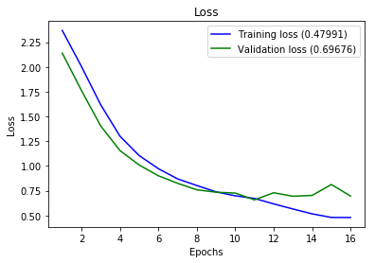
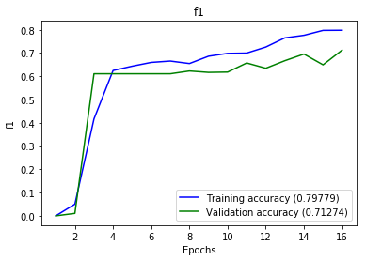
Implementation of models The Results
Over-fitting was prevented by a callback named “early stopping”
f1 score increases with the number of times we run the model
Loss
f1 score
“Only when you're working that intersection of business and technology do you bring things together.”
Mike Dargan, Group CIO

Slide 5
Ranking methodology
Popularity Score is the weighted average of the number of retweets, likes and comments
In our ranking methodology, we believe the number of likes is the most important factor in determining the popularity of a topic and hence has the highest weighting (40%)
Popularity Score = A x Number of likes+ B x Number of likes + C x Number of comments
A = Weight of likes (40%)
B = Weight of retweets (35%)
C = Weight of comments (25%)
“Only when you're working that intersection of business and technology do you bring things together.”
Mike Dargan, Group CIO

Slide 6
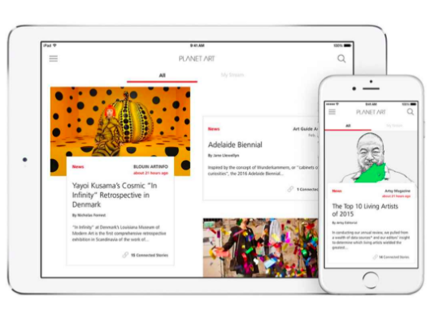

Marketing solution Develop an ecosystem of apps based on UBS’s “Planet Art”
Planet Art provides an overview of art news, reviews and information across the art world
Based on our rankings of the popularity of different topics across cities in China, we can develop other “Planet” apps to provide news/ insights of that topics to the clients
Planet Art
UBS Planet Ecosystem
“Only when you're working that intersection of business and technology do you bring things together.”
Mike Dargan, Group CIO

Slide 7
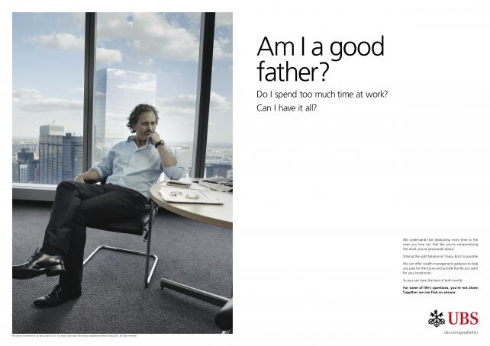
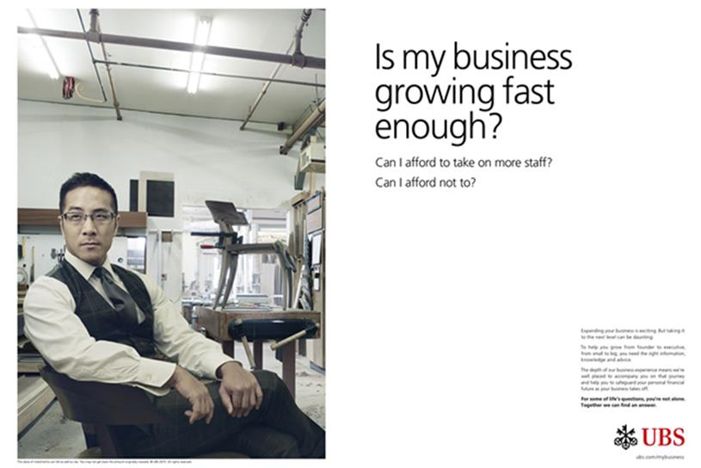
Marketing solution Tailor topic-specific advertisements to different KOLs
After knowing the ranking of the interest categories of the city that the commentators are based in, UBS can work with the KOLs to tailor specific advertisements/ marketing campaigns
Education
Finance/ Real Estate
“Only when you're working that intersection of business and technology do you bring things together.”
Mike Dargan, Group CIO

